Slide 1
Public-Private Dialogue
SEPTEMBER 2018 - Serbia PPD KNOWLEDGE EXCHANGE
What I know so far
(but you collectively know more)
WHATEVER WE ALL KNOW, IT’S HERE:
Benjamin Herzberg
World Bank Group
www.publicprivatedialogue.org

Slide 2
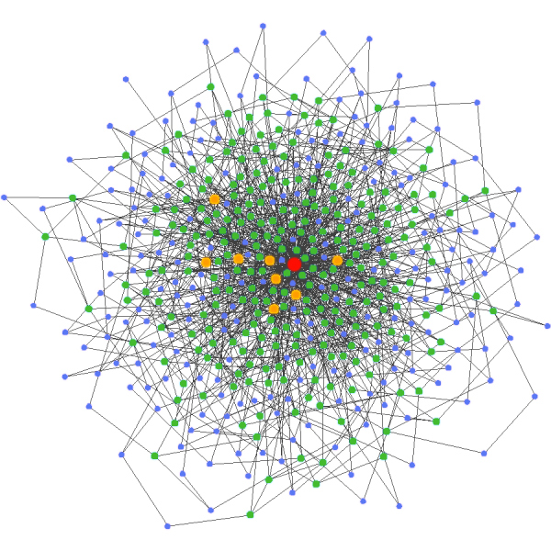
2

Slide 3

Where can I get some funds to run my business?
How do I reach the right export markets for my products?
Where do I get workers with the right skills?
How do I make sure I have enough electricity?
What rules and regulations do I have to comply with?

Slide 4
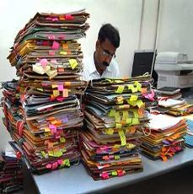
How can we help banks give more SME loans?
What trade deals would most benefit my country?
How can I help ensure that our work force is skilled?
What infrastructure should I build?
How can I best regulate the private sector and promote innovation?

Slide 5

Where can I get some funds to run my business?
How can we help banks give more SME loans?
Where do I get workers with the right skills?
How do I reach the right export markets for my products?
How can I help ensure that our work force is skilled?
What trade deals would most benefit my country?
How do I make sure I have enough electricity?
What infrastructure should I build?
What rules and regulations do I have to comply with?
How can I best regulate the private sector and promote innovation?

Slide 6
Where can I get some funds to run my business?
How can we help banks give more SME loans?
What trade deals would most benefit my country?
How do I reach the right export markets for my products?
Where do I get workers with the right skills?
How can I help ensure that our work force is skilled?
What infrastructure should I build?
How do I make sure I have enough electricity?
What rules and regulations do I have to comply with?
How can I best regulate the private sector and promote innovation?

Slide 7
PPD Collaborative Action Matrix
1 | 2 | 3 | 4 | 5
Regulatory and tax environment | Infrastructure | Access to finance | Skilled and trained labor | Access to technologies and R&D
1 | Public
2 | Public-Private
3 | Private
Kassim and Herzberg, World Bank Group

Slide 8
but risk is manageable
PPDs are risky business
1- Political Economy, Institutional misalignments (e.g. Uganda NF, Benin)
2 - Reinforcing vested interest (e.g. Mongolia, Belarus)
3 - Over and under representation (e.g. Tanzania, 18%, Benin 6/6/6)
4 - One man shows (e.g. Botswana)
5 - Sustainability issues (e.g. Bolivia, Cameroon, Liberia)
6 - Political risks (e.g. Bosnia, Bangladesh)
Source: Herzberg, World Bank Group, Wright and Sisombat, 2006/2013
8

Slide 9
PPD CHARTER OF GOOD PRACTICE
PRINCIPLE I: CONTEXTUAL DESIGN
PRINCIPLE II: OPEN GOVERNANCE PROCESS
PRINCIPLE III: MANDATE AND INSTITUTIONAL ALIGNMENT
PRINCIPLE IV: STRUCTURE AND PARTICIPATION
PRINCIPLE V: FACILITATION
PRINCIPLE VI: CHAMPIONS
PRINCIPLE VII: OUTPUTS
PRINCIPLE VIII: OUTREACH AND COMMUNICATIONS
PRINCIPLE IX: MONITORING & EVALUATION
PRINCIPLE X: APPROPRIATE AREA AND SCOPE
PRINCIPLE XI: CRISIS AND CONFLICT RESPONSE
PRINCIPLE XII: DEVELOPMENT PARTNERS
PRINCIPLE XIII: SUSTAINABILITY

Slide 10
PRINCIPLE I: CONTEXTUAL DESIGN
PPD can take several forms and can take place at various levels within different timeframes.

Slide 11
PPD Typology
Typology of PPDs: 7 inter-locking types
National
Economy-wide
Permanent institution
Public-driven
3rd party brokerage/support
General orientations/ Many goals
Many actors
Area
Local
Sector-specific
Temporary initiative
Private-driven
Locally driven/sustained
Specific changes / Specific goal
Few actors
Scope
Institutionalization
Leadership
Ownership
Focus
Participation
Herzberg , World bank Group, 2013
11

Slide 12
Typology of PPDs: 7 inter-locking types
PPD Typology
National
Economy-wide
Permanent institution
Public-driven
3rd party brokerage/support
General orientations/ Many goals
Many actors
Area
Local
Sector-specific
Temporary initiative
Private-driven
Locally driven/sustained
Specific changes / Specific goal
Few actors
Scope
Institutionalization
Leadership
Ownership
Focus
Participation
Herzberg , World bank Group, 2013
12

Slide 13
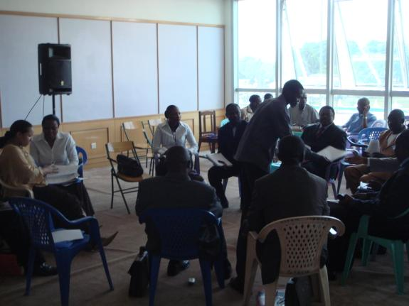
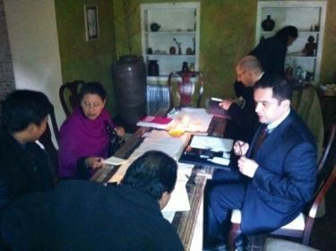
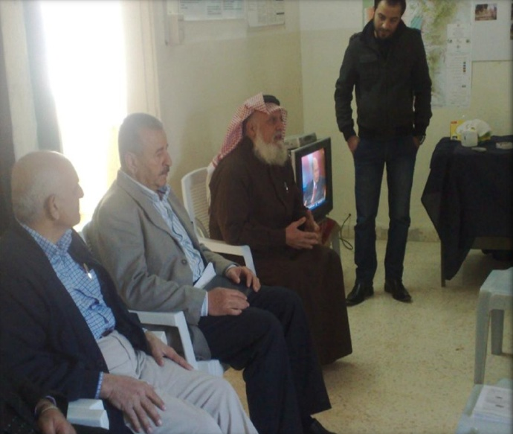
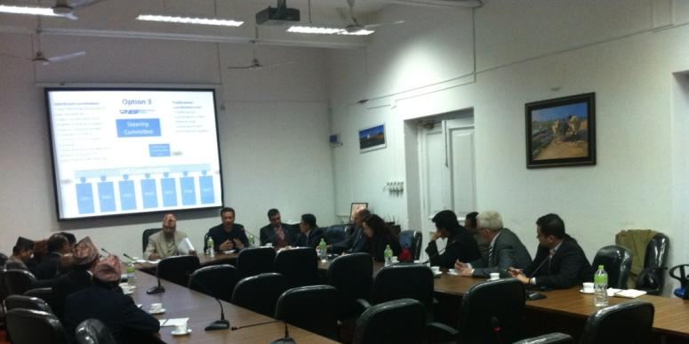
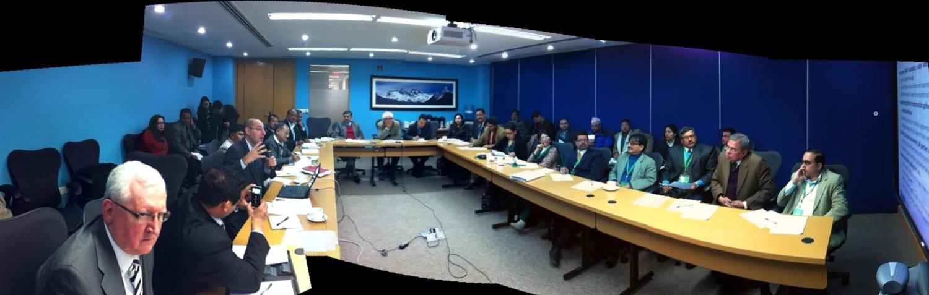
Lots of Consultations!
Source: Private Sector For Good Governance Program, 2001-2013 Programs

Slide 14
Project brief
Sector constraints(Existing benchmarks and surveys)
Stakeholder investigation(Field interviews and focus groups)
Private sector
Intermediaries
Public authorities
Civil Society
Development partners
Most significant reforms (Field interviews and focus groups)
Stakeholder analysis
Report composition –Design recommendations

Slide 15
PRINCIPLE II: OPEN GOVERNANCE PROCESS
PPD needs to function under open, transparent and fair governance rules. PPDs will be more likely to succeed if their governance structures are designed to best take into account political economy factors.

Slide 16
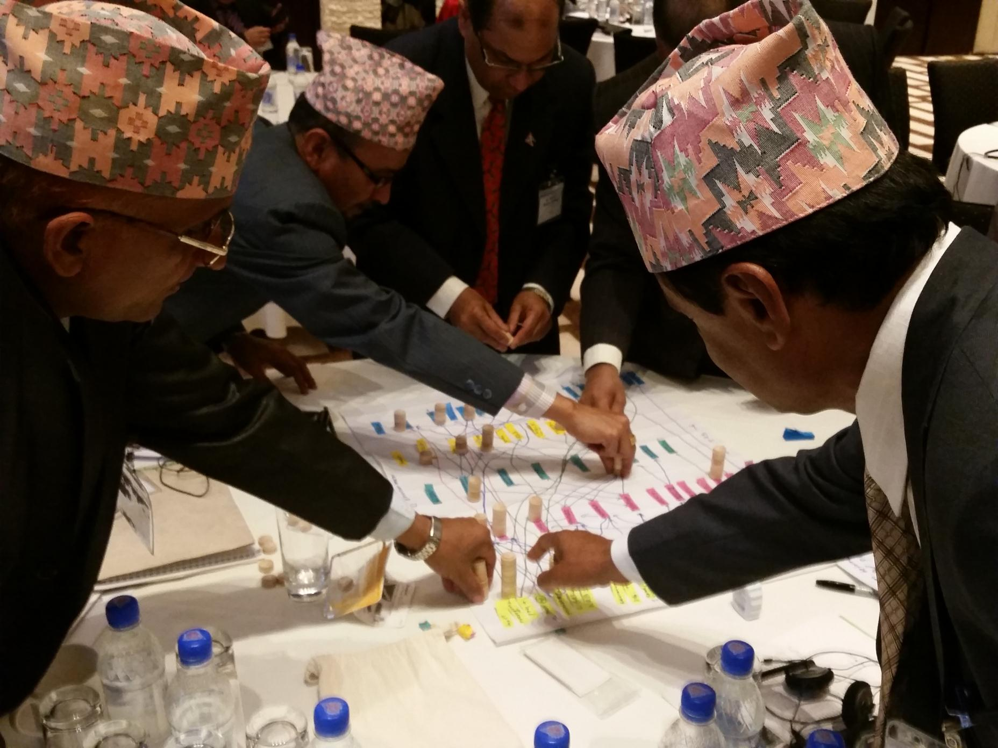

Slide 17
Prerequisites
Consider 4 dimensions to start it
CHAMPION
Public Authorities:
Engagement means sufficient capacity, political will and leadership.
Business community:
Needs to be somehow organized, led and feel a basic sense of security.
Champion:
Needs credibility, expertise
and the ability to get media attention
Instruments:
Need logistical facilities, seed funds (may also supplement champion in QA)
Strong
BUSINESS COMMUNITY
Weak
PUBLIC AUTHORITIES
Strong
Strong
Strong
INSTRUMENTS
Source: Herzberg , World Bank Group, 2005
17

Slide 18
PPD Diamond
Private sector dimension | Score from 0 (weak) to 5 (strong)
Sophistication level of the organization and legitimacy amongst private stakeholders (organization) | 1
Capacity to coordinate and align different groups (coordination) | 5
Level of power and leverage with respect to public stakeholders (leadership) | 3
Willingness to invest time and money in conjunction with public partners (motivation) | 3
Compliance to engage in more attractive business models | 2
Quality of business leaders (understanding of private sector’s needs and strategic challenges, not only conducting a political role or rent seeking activities) | 3
Motivation and leadership to conduct public-private projects | 2
Average score | 2.7
Public sector dimension | Score from 0 (weak) to 5 (strong)
Generalized trust and understanding of the private sector | 5
Political will to engage with the private sector | 5
Capacity to understand the private sector | 2
Dedicated public sector leadership assigned to dialogue process | 3
Capacity to effectively follow up public-private projects | 4
Willingness to adapt institutions and public programs to the evolving needs of the private sector (reforms) | 2
Quality of sector driven policies (looking for private actors engagement and fostering innovation) | 2
Coordination at different public levels regarding specific private sector needs | 2
Average score | 3.1
Champion dimension | Score from 0 (weak) to 5 (strong)
Capacity and legitimacy to break conventional wisdom | 2
Understanding of private sector challenges and strategies to overstep them | 3
Emergence of new champions (are there any new leaders stepping in?) | 4
Complementarities and coordination of different champions | 0
Average score | 2.3
Instruments dimension | Score from 0 (weak) to 5 (strong)
Quality of programs and mechanisms to help private sector development | 1
Sector specific instruments responding to private sector strategic needs | 0
Capacity to support innovative projects used later on as success cases | 9
Level of bureaucracy to have access to the instruments | 2
Complementarities of available instruments to support different aspects of the same project or private sector strategy | 5
Average score | 3.4

Slide 19

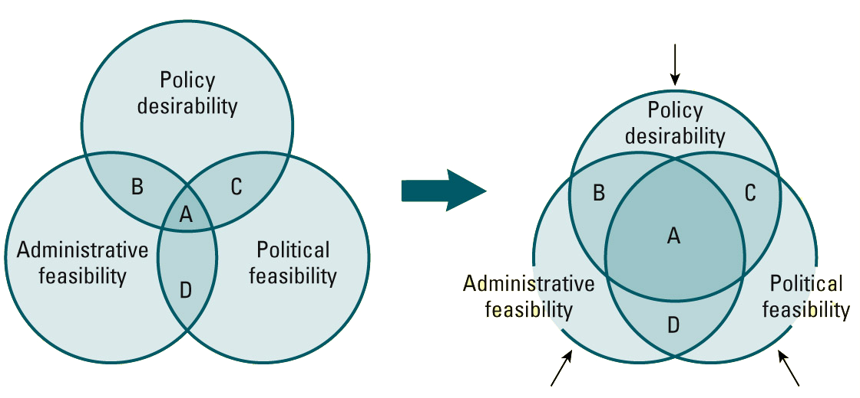
expending the reform space
Innovation
“What to do”
Reform
Coalition
Learning
“How to do it”
Leadership
“Who makes it happen”
The only reforms that
really work and are
truly sustainable
Herzberg , 2011

Slide 20
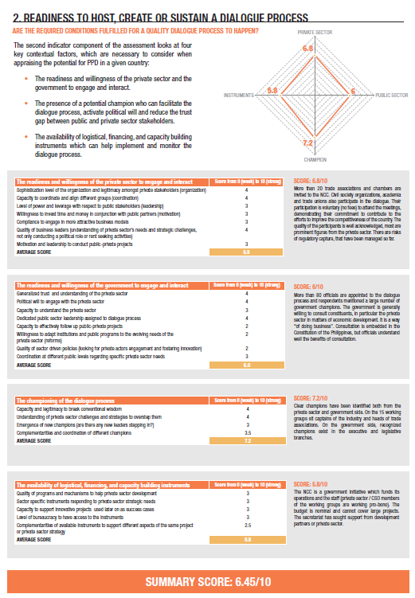
20

Slide 21
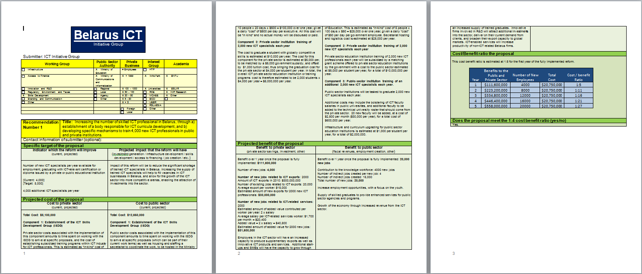
21

Slide 22
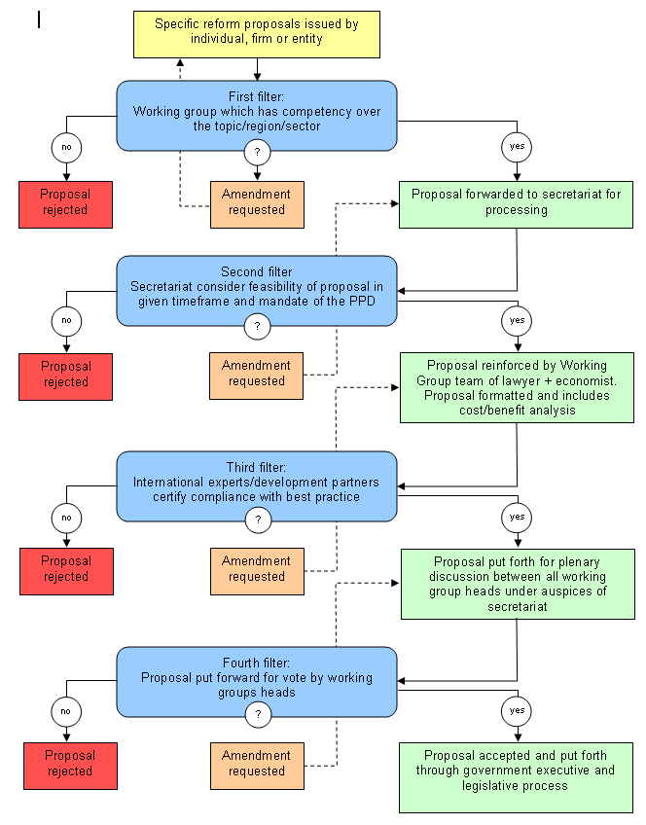
Filtering Process to Ensure Transparency and Fairness
Source: PPD Handbook
22

Slide 23





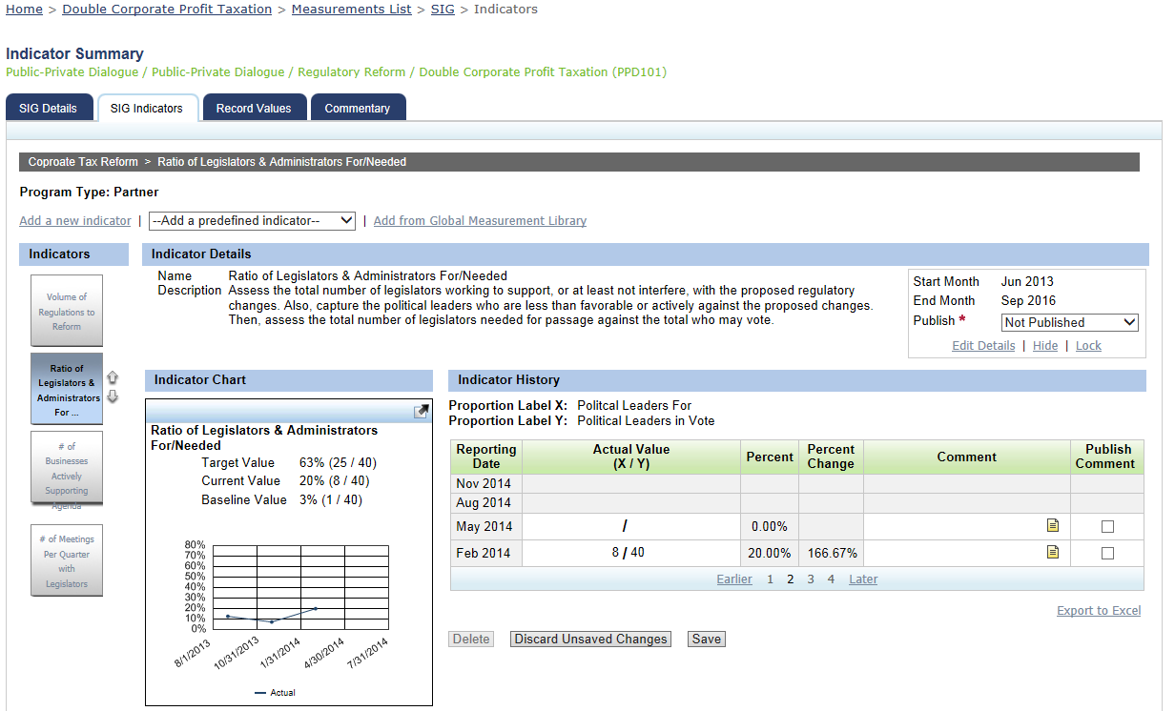
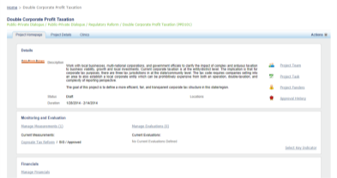
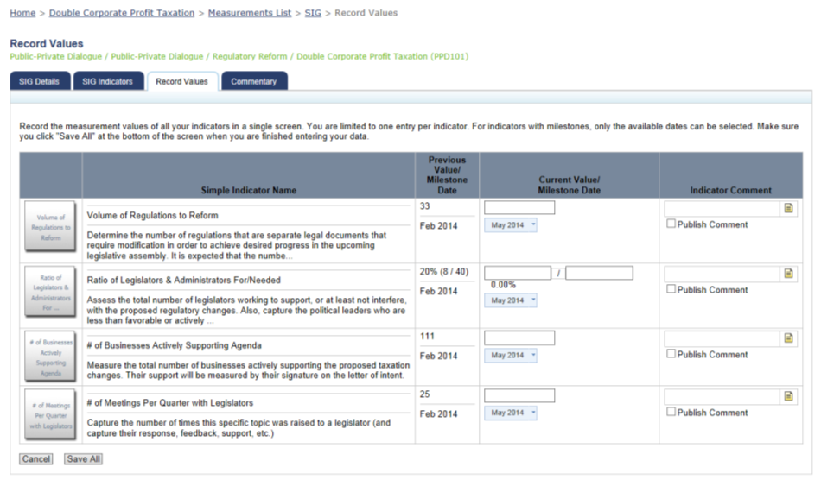
Collect & Manage Reform Proposals
_{Monitor}
Track reform proposal status
Define M&E plans and deploy a data collection tool for key indicators and other data (pictures, stories, etc.)
Create custom indicators…
…or select standards from the organization’s library
Define baselines, set targets and support capture data real-time
Quick trend visualization
Capture information, not just data

Slide 24
PRINCIPLE III: MANDATE AND INSTITUTIONAL ALIGNMENT
A statement of objective is helpful for clarity. A formal or legal mandate can be an important help in some political and economic contexts, but mandates are never sufficient to establish good PPD. Wherever hosted and whenever possible, PPD should be aligned with existing institutions to maximize the institutional potential and minimize friction.

Slide 25
Institutional coordination (or not)
Ministère Economie et Finances
Parlement
CCIB
Conseil Eco. et Social
CNPB
Ministère Commerce Industrie et PME
HCGC
PROCCI
CIPB
UCF-MCA
ANPME
APBEFB (Banques)
Ministère du Développement
APEBEC / filières
AFACEB (femmes)
Concertation “fiscalité”
Chambre Agriculture
Primature
Dispositif de Suivi
UE PADSP
Chambre des métiers
Ministère de l’Agriculture
Relance Economique
Filières
Ministère Economie Maritime
ADEX
Port de Cotonou
Source: Benin Investor Council, Private Sector Engagement for Good Governance, World Bank, 2012
CPI
Associations logistiques
25
25

Slide 26
Source: Mandell, Hijazi, Herzberg, World Bank Group, 2012

Slide 27




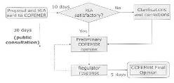
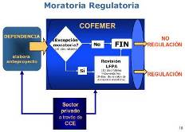
Linking the PPD to Other Reforms Processes
SEZ
Reform Unit
Value chain
Clusters
$
Open governance initiatives (e.g. open budgets)
Regulatory simplification
RIA and regulation review process
27

Slide 28
Institutional alignment
Possible host | Strengths | Weaknesses
President’s / Prime Minister’s Office | Top-level political backing and a remit that stretches across different government departments and agencies. | Risk of creating “turf war” antagonism with other government agencies. Risk of political over-reliance on the individual figure of the president or prime minister of the day. Risks being seen by private sector as a government mouthpiece rather than a genuinely neutral space for dialogue.
Ministry of Finance or Trade | Likely to offer the most direct access to relevant decision-makers. | Risks narrowness of view on activities that impinge on other departments or agencies. Risks being seen by private sector as a government mouthpiece rather than a genuinely neutral space for dialogue.
Investment promotion agency or similar agency | Offers possibility of secretariat being hosted in an agency which already has a track record of promoting business climate improvements. | Vulnerable to weaknesses in agency such as ineffectiveness, narrowness of remit or negative perceptions on the part of some important stakeholders.
Chamber of Commerce or other BMO | Can ensure that a wide range of member businesses are aware of and have easy access to the secretariat, and build the capacity of the Chamber or BMO in other respects. | If there are several Chamber/BMOs, to locate the secretariat in one risks alienating the other. Risk of being seen by government as more of a private sector mouthpiece than neutral space for dialogue.
International organization | Likely to have surest access to international best practice, trained personnel and funding. Can be perceived as a neutral, honest broker. | Risk of fostering dependence on external donors rather than local ownership of the dialogue process. Can be unhelpful for public image when donors and viewed negatively.
New and independent institution | Best chance of being perceived by all stakeholders as a disinterested, neutral facilitator. | Need to start from scratch with no existing institutional strengths to take advantage of.
Source: PPD Handbook
28

Slide 29
PRINCIPLE IV: STRUCTURE AND PARTICIPATION
PPD should have a solid structure and a representative participation. The structure should be manageable while flexible, enable participation to be both balanced and effective, reflect the local private sector context and stakeholders’ interests.

Slide 30
Public-Private Mandate
Coordinating secretariat
Working group 1
Working group 2
Working group 3
Working group 4
Working group 5
Private sector advocates, associations, government representatives, donors
Source: PPD Handbook, 2011
30

Slide 31
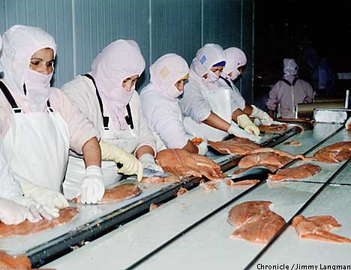
Sector-Specific
SALMON EXPORT FACILITY IN CHILE

Slide 32
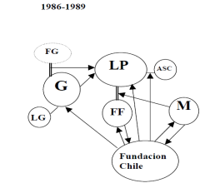
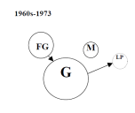
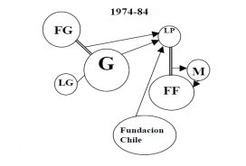
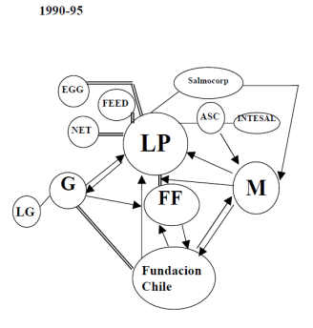
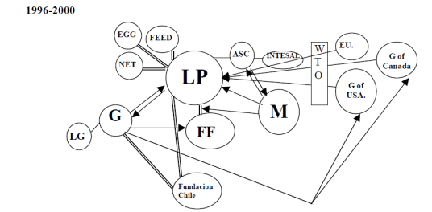
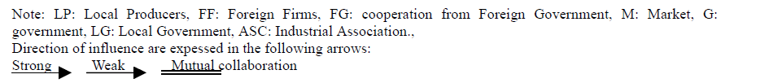
Sector-Specific

Slide 33
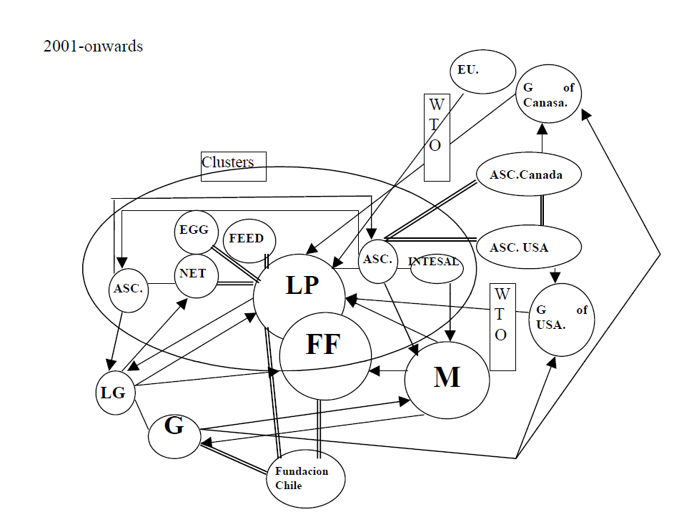
Sector-Specific

Slide 34
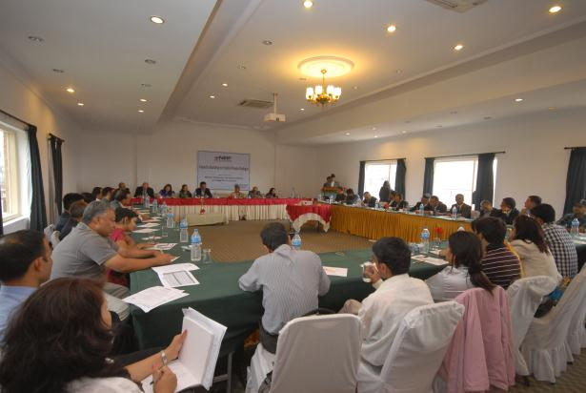
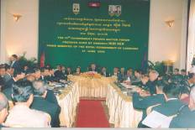
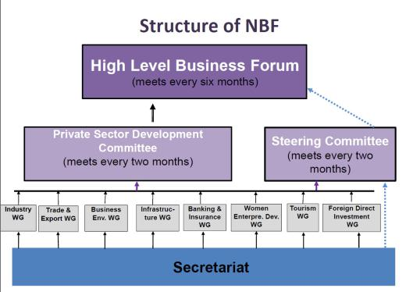
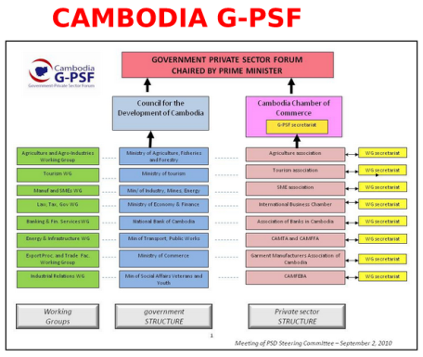
National
Nepal Business Forum Cambodia Business Forum

Slide 35
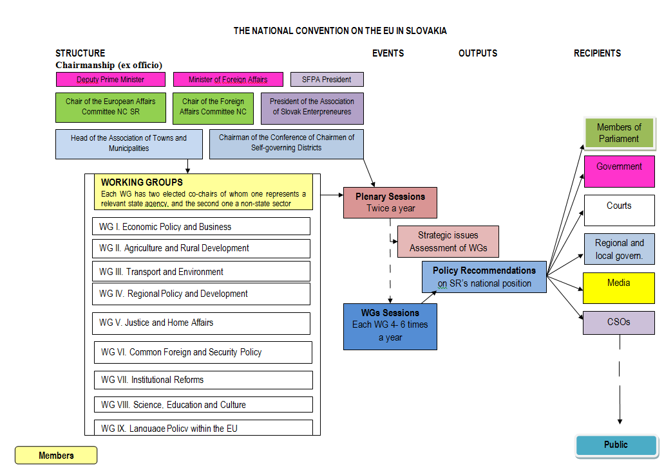

Slide 36
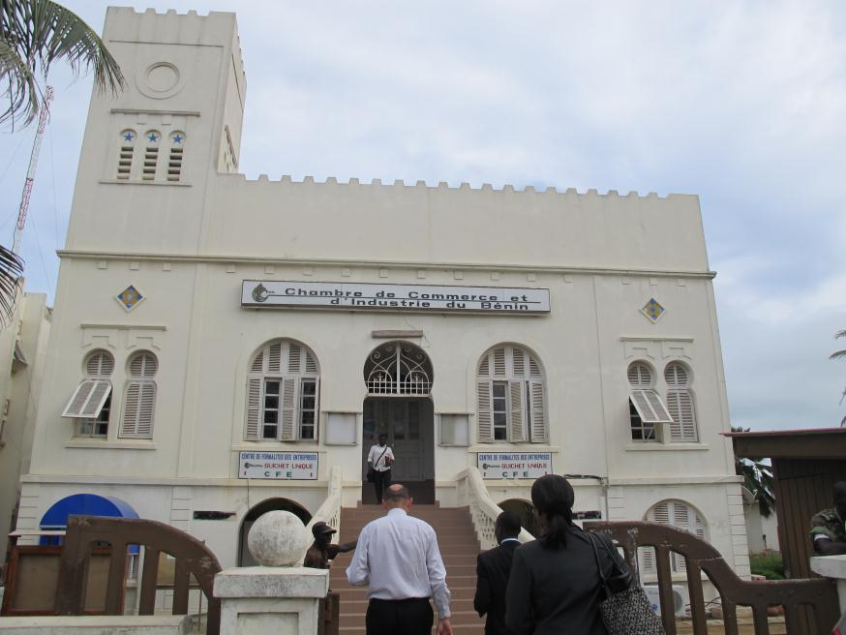
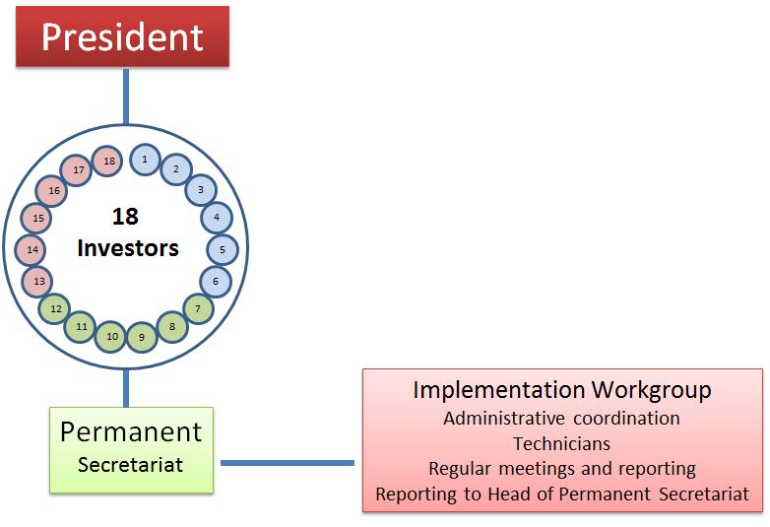
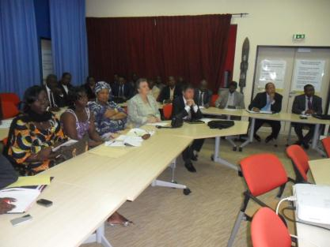
national

Slide 37
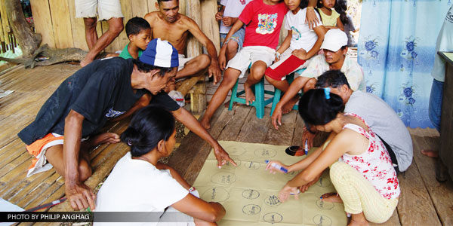
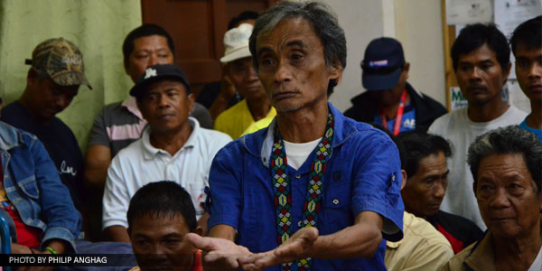
Community-Specific
Caraga is an administrative region of the Philippines, on the northeastern portion of the island of Mindanao. Rich in natural resources, it has great potential for development. It is characterized by a wood-based economy, extensive water resources and rich mineral deposits, such as iron, gold, silver, nickel, chromite, manganese and copper.
Multi-stakeholder dialogues
Participatory land use planning,
Strengthening of community-based “wardens”
Watershed protection in marginalized communities
Reduction of violent conflicts on the use of these resources.

Slide 38
PRINCIPLE V: FACILITATION
The PPD process gains to be facilitated professionally with dedicated people and resources so as to efficiently manage all aspects of the dialogue process with a view to deliver results.

Slide 39
Structured dialogue → Workable Projects → Projects that work
Diagnostic
Solution
Design
Implementation
Monitoring &
Evaluation
Engagement
Definition
Empowerment
Consensus building
Filtering
Ongoing support
Watchdog
Resources
Watchdog
Feedback loop
PPD contributes to all steps of project process
Source: Herzberg and Palmade, World Bank Group, 2006
39

Slide 40
Good Planning
Source: Bosnia Herzegovina, Bulldozer Committee, 2011
40

Slide 41
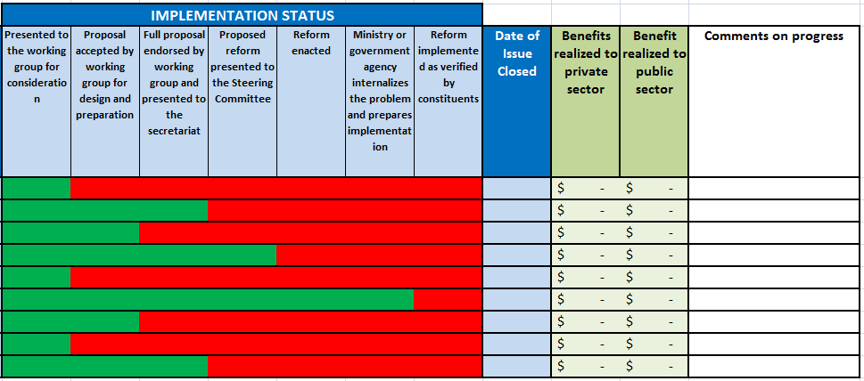
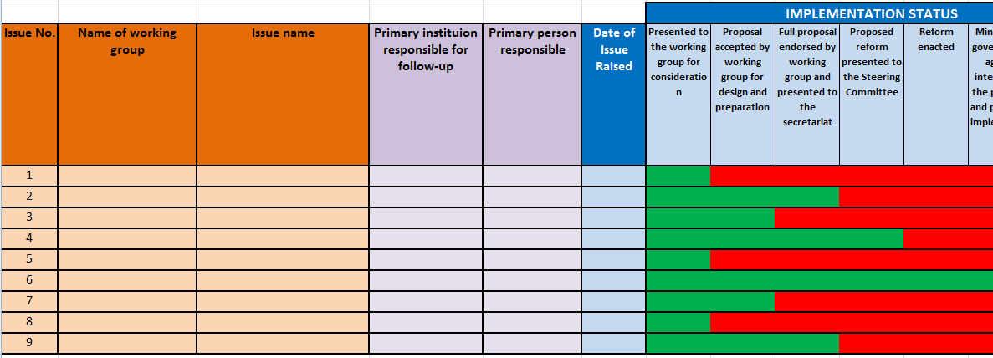
Tracking system for accountability
41

Slide 42
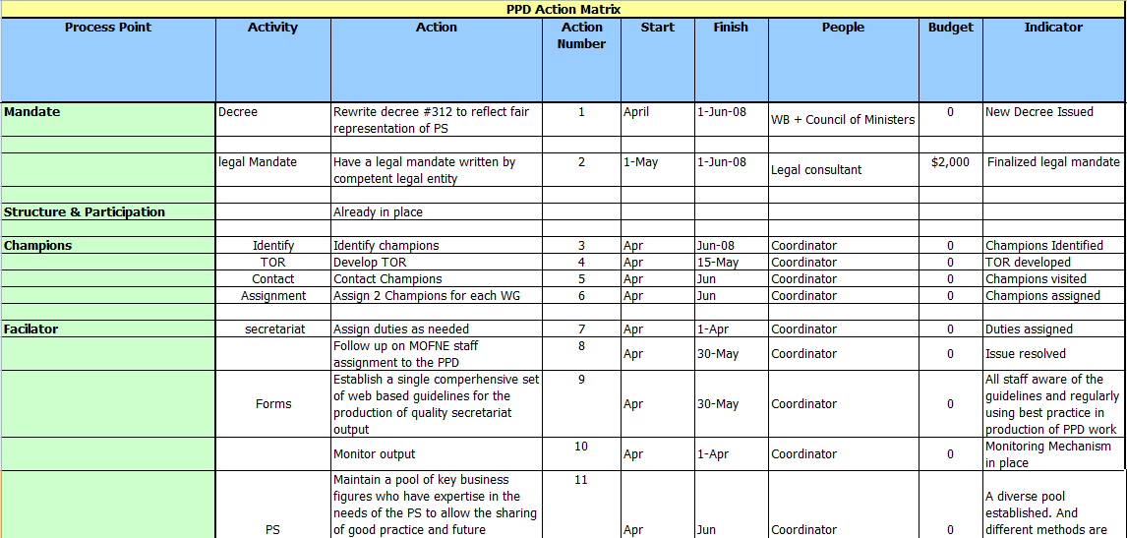
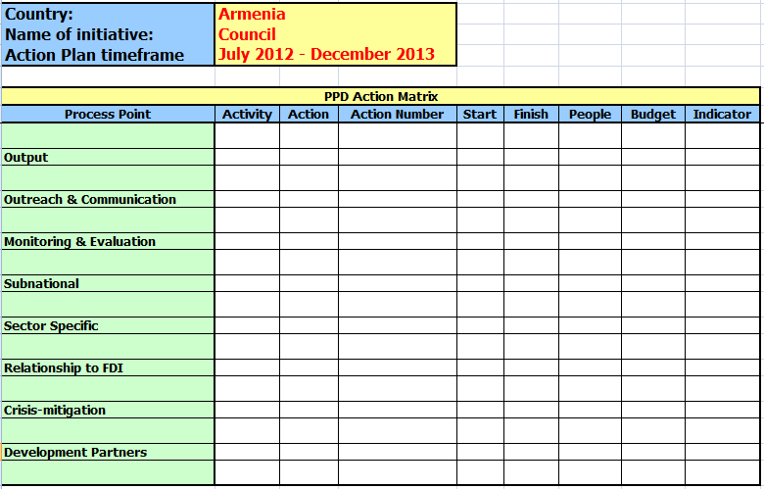
Action planning
Source: Herzberg, World Bank Group, 2011
42

Slide 43
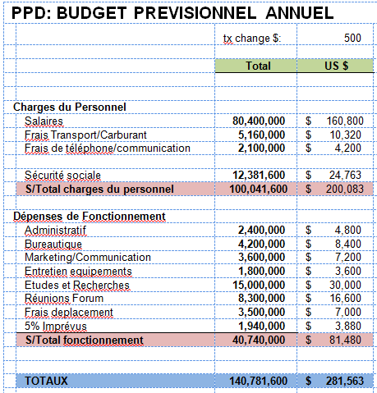
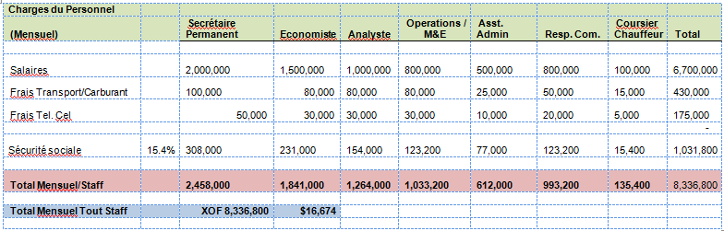
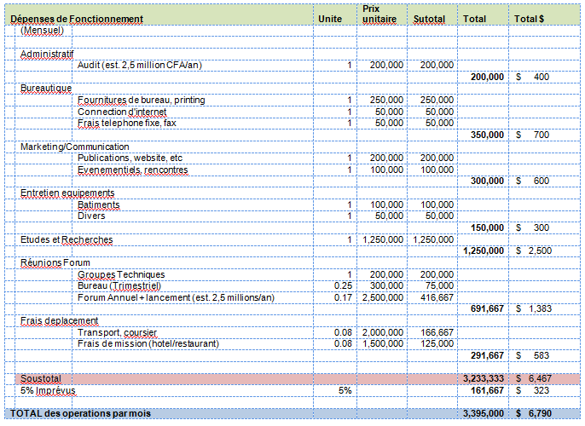
Budgeting
Source: Private Sector Engagement for Good governance Program, WB, 2011
43

Slide 44
PRINCIPLE VI: CHAMPIONS
Leadership from a set of individuals or organizations is often necessary to reduce the trust gap, to sustain the energy and keep pushing for involvement of the parties over the long run.

Slide 45
PRINCIPLE VII: OUTPUTS
Outputs can take the shape of structure and process outputs, analytical outputs, soft outputs or recommendations. While all should contribute to agreed private sector development outcomes, the PPD should aim for tangible, practical and measurable benefits.

Slide 46
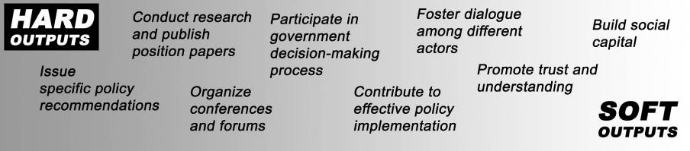
Several Types of Outputs
Focusing on this
will bring the others
Source: PPD Handbook
46

Slide 47

NBF Advocacy Effectiveness
Working Group | Total Issues | Achieved | Pending Issues
Export Promotion and Trade Facilitation | 10 | 4 | 6
 | 100% | 40% | 60%
Infrastructure | 8 | 1 | 7
 | 100% | 13% | 88%
Financial Monetary and Insurance Affairs | 14 | 4 | 10
 | 100% | 29% | 71%
Business Environment, Labor Relation and Industrial Security | 12 | 3 | 9
 | 100% | 25% | 75%
Industrial Promotion | 18 | 6 | 12
 | 100% | 33% | 67%
Women Entrepreneurs | 12 | 2 | 10
 | 100% | 17% | 83%
Tourism | ? | ? | ?
Source: Howard 2012, extracted from Nepal Business Forum Record
47

Slide 48
NBF Advocacy Effectiveness = 22%
Source: Howard 2012, extracted from Nepal Business Forum Record
48

Slide 49

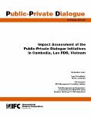
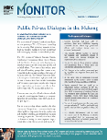
EVIDENCE OF DEVELOPMENT EFFECTIVENESS
2005:
Independent evaluation of 5 Investors Advisory Councils in Africa
2007:
Independent evaluation of 3 Business Forums in Mekong
2009:
Independent evaluation of 30 WBG-sponsored PPD
2011:
Impact assessment of 4 IC country programs (Rwanda, Liberia, Sierra Leone, Burkina Faso)
2012:
IFC internal evaluation of IC programs and
their development effectiveness
2012:
impact of IC programs in Fragile and Conflict Affected States
Aceh 2008
Albania 2008
Bangladesh 2007
Belarus 2007
Cambodia 1999
Chad 2008
Cameroun 2008
CAR 2007
Ethiopia 2008
Laos 2005
Liberia 2007
Nepal 2008
Pakistan 2008
Sierra Leone 2007
Romania 2006
Senegal 2002
North Sudan 2007
South Sudan 2007
Tanzania 2002
Timor Leste 2008
Tonga 2005
Uganda 2004
Vanuatu 2008
Vietnam 1997
Zambia 2007
Benin N/A
Ghana 2002
Mali 2004
Over 400 reforms achieved in over 50 distinct areas
Economic impact (private sector savings)
  Conservative estimate: $500 millions
Cost effectiveness
  Start-up investment of 100k-200k
Extracted from WBG Independent Evaluations, 2011
49

Slide 50
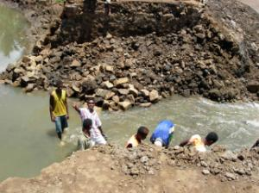
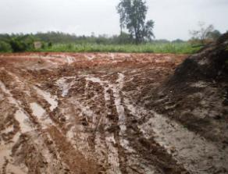
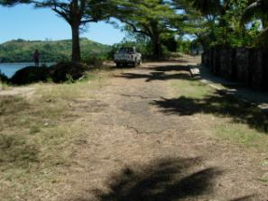
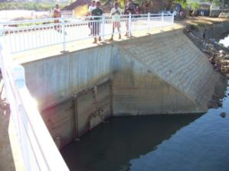
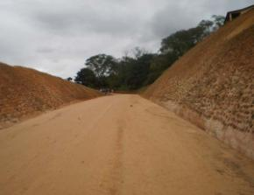

PPD Impact On Road Repair in Nosy Be & Fort Dauphin
Nosy Be Pont cassé
RIP 118 : Soanierana – Ranomafana
Rue Camille Valentin Nosy Be
Source: Uy, 2011 (Madagascar Growth Pole project, FPD Africa, World Bank Group)
50

Slide 51

Competitiveness Payoffs - Cambodia Garment
Two reductions of Export Management Fee has
saved GMAC members USD 2,2 millions (2008)
Reduction of bureaucracy and documentation
required for import-export procedures;
Certificate of Origin now issued within 48 hrs, with reduced cost and documentation (2 GMAC staff are positioned at MoC to assist factories in C/O applications);
Introduction of the ASYCUDA system which has automated export documentation, saving time and money;
Export procedures made transparent and communicated
Reduced the employers’ contribution to the National Social Security Fund from 1.8% to 0.8%
New Union Law established
Decade-long Night Shift dispute resolved (night rate from 200% to 130%)
Source: Van Sou Leng, 2009
51

Slide 52

Cambodia’s garment exports results
4,000
Van Sou Leng, 2011
52

Slide 53
PRINCIPLE VIII: OUTREACH AND COMMUNICATIONS
Enabling communication of a shared vision and understanding through the development of a common language is essential for building trust among stakeholders and keeping them engaged.

Slide 54










Bosnia Bulldozer initiative, “50 reforms in 150 days”
Nigeria PPD
Georgia legal and judicial reform
From the Protocols for Prosperity... To the Prosperity Garden (Bosnia)
Accountability gets specific in Bosnia (corporate governance reform)
Cambodia SME credit reform – TV shows on location (SMEs) + Experts
Source: PPD Handbook
54

Slide 55


Source: Respective Websites
Herzberg , 2011
55

Slide 56
PRINCIPLE IX: MONITORING & EVALUATION
Monitoring and evaluation is an effective tool to manage the public private dialogue process and to demonstrate its purpose, performance and impact.

Slide 57

57

Slide 58




Tools and Techniques for Monitoring + Evaluation
Source: PPD Handbook, PPD Evaluations
58

Slide 59







PPD COUNTRY PROFILE:
1- Legal and regulatory context for PPD
2- Country’s readiness to host, create or sustain a dialogue process
3- Organizational effectiveness of a given platform

Slide 60
PRINCIPLE X: APPROPRIATE AREA AND SCOPE
The dialogue process should be tailored to the set of issues to be addressed and consider the implications for sub-issues that are part of a larger agenda and smaller jurisdictions which can play a role in the change process. Local and sector specific public private dialogues have strong potential for focused results. National and economy-wide platforms and local and sector specific initiatives would gain in coordinating their agendas so as to best serve the interests of their constituencies.

Slide 61



Rose Farming in Ethiopia
Call Centers in India
Asparagus Farming in Peru

Slide 62


Sector Growth Through PPD
Comparison of 2 sectors in 5 countries (Egypt, Lebanon, Malta, Spain and Turkey) + Comparison of 10 different PPD case studies in one region of Spain - Catalonia
Source: Herzberg , Kassim, Majumdar, Sudan, Stanford University research team, Watson, Zeng, World Bank Group, 2011
62

Slide 63


What action are best for the sector?
For instance, is infrastructure is important?
Cruise sector – Spain
Source: Duch, Competitiveness LLC, 2011

Slide 64

Sustainable Cleveland 2019
64

Slide 65








2014 → Current working groups
Notes:
*indicates former Sustainable Cleveland Working Groups that have now formed their own organizations.
Working groups are an essential part of the Sustainable Cleveland initiative because they continue Summit momentum throughout the year and help to expand the reach to various communities. Working groups are all volunteer based – anyone can get involved.
Currently, the Advanced and Renewable Energy topic does not have any working group, but it is open for interested individuals or groups who want to start one.
Another bunch of working groups are either no longer active or are being reorganized, including:
Year-round Food Production/Season Extension
John Hay HS Fresh Food Collaborative
Sustainable Business Incubator
Communications Resources
Green Dots
Public Compact
Social Capital Working Group
Advanced Energy Generation
Sustainable Design, Materials, and Manufacturing
Growhio
Green Building
Collective Upcycle*
Menu for the Future

Slide 66
Results (as of 2014)
377 acres have been cleaned up since 2009
2,262 new clean economy jobs between 2010 and 2012
Clevelanders with Clean Economy Jobs make 5.7% more
52 new certified “sustainable” businesses in Cleveland and Northeast Ohio since 2010
8.3% increase in GDP in Northeast Ohio since 2009
300 energy audits & 150 retrofits saving 37% on average through Energy$aver pilot
3000+ apartment & single family units have met the Cleveland Green Building Standard
65,000 homes & small businesses receiving 100% green energy & 21% cost savings
70 bins installed through the Downtown Recycling Pilot completed in August 2014
12 green infrastructure projects started in Cleveland’s neighborhoods by the Sewer District
50 businesses publicly reporting their sustainability success
1,000 new trees to be planted through the Western Reserve Land Conservancy
Source: “Sustainable Cleveland – Report from the Community”, May 2014 http://www.sustainablecleveland.org/resources/report-from-the-community/

Slide 67


INVOLVEMENT LEVELS
Notes:
For each level of involvement (Home, Work, Community), there ways to explore the Celebration Points, join a Working Group and attend an upcoming Annual Summit.
For each of these levels of involvement there are specific ways to contribute to each celebration point. For example, getting involved with the Energy Efficiency topic in the three levels:
HOME:
Get an Energy Audit to understand the opportunities for cost savings and energy efficiency. There are several programs that offer rebates, including Cleveland Energy $aver, Efficiency Smart for Cleveland Public Power consumers, and Good Cents. The Home Weatherization Assistance Program (HWAP) offers grants to qualified residents through the State of Ohio.
Install a programmable thermostat and program it to 68 during the day when you are home and 55 when you go to sleep or are away from home. Wear sweaters inside the house.
Install low-flow showerheads and try to take shorter showers.
Weatherize doors and windows. Go to Environmental Health Watch’s Energy Saving Tips handout for instructions.
Control phantom loads (appliances/electronics that use energy when powered off, but still plugged in).
Turn off lights when not in use.
Get rid of that extra refrigerator or freezer in the basement-it’s probably an energy hog.
Set hot water heater thermostat no higher than 120F and insulate the hot water tank (but be careful with gas water heaters and follow instructions).
Replace incandescent light bulbs with more efficient bulbs, such as CFLs or LEDs.
Purchase ENERGY STAR® rated appliances and products for your home.
If building new, build green and save thousands of dollars through the City of Cleveland Residential Tax Abatement program and possibly other programs.
Use blinds and shades to let the sun’s heat in
Buy laundry detergents that work well in cold water and wash clothes in cold water, wash bigger loads, and wear clothes more than once.
Replace furnace filter regularly
Install Compact Fluorescent Lights (CFLs) and dispose of properly
Air seal gaps and cracks and ducts in unconditioned spaces
Insulate and air-seal rim joists. Rim joists are located where your basement wall meets the floor above. Cut foam board insulation to fit and caulk or foam around the edges.
When making your home energy efficiency improvements check for home health hazards, such as: deteriorating lead paint, a disconnected dryer vent, mold and moisture problems, pests, asbestos, faulty wiring, hazardous chemicals, batteries in smoke and CO detectors.
WORK:
Undergo a comprehensive energy assessment (or audit) to understand which cost-effective opportunities are available at your facility.
If you’re a small business, join the COSE Energy Choice Program to get a comprehensive energy assessment and access to utility rebates and incentives.
Join the Cleveland 2030 District to collaborate with other building owners seeking to easily manage their energy use.
Focus on operational/behavior changes first, as they are often no cost or low cost options. For example, turn down the thermostat a few degrees in the winter, close off unused rooms, turn off lights, unplug electronics, etc.
Upgrade lighting, as it is likely your largest source of electric consumption. An average office space uses 50%+ of electricity on lighting. Lighting upgrades also have short payback periods and often increase productivity.
Make sure to complete routine maintenance. Cleaning lighting fixtures and windows regularly allows more light to permeate your office, and replacing HVAC filters as scheduled can allow the system to operate more closely to optimum efficiency levels.
Consider switching some IT systems to the “cloud.” Options like Software-as-a-Service (SaaS) and Platform-as-a-Service (PaaS) can allow your organization to cut down on IT & server energy consumption while increasing ease of access and data security.
Adopt a workplace policy to turn off computers and monitors at the end of the work day.
Purchase ENERGY STAR® rated products for your organization.
COMMUNITY:
If you are a member of a faith-based organization, consider joining Ohio Interfaith Power and Light.
Educate children about energy conservation to help them make informed energy choices throughout their lives — saving energy now and helping preserve our natural resources for years to come.
Help your neighbors to understand the benefits of making small changes to become more energy efficient and help seniors install items such as compact fluorescent bulbs, programmable thermostats and low flow shower heads.
Support existing programs that provide residential energy efficiency education and incentives.
Participate in a neighborhood level energy efficiency or green building challenge.
Work with utilities and other stakeholders to explore strategies for easily accessing energy data and financing energy efficiency upgrades.

Slide 68

SC2019 Celebration points
Notes:
This plan is flexible. Every three years, the order will be re-set by the SC2019 Stewardship Council.
SC2019 Celebration Points: every year leading up to 2019, Cleveland will focus on one of the key areas fundamental to a sustainable economy.
Each Celebration Point is not an end or a beginning to the work - in order for real transformation to take place, all of the areas outlined will need a consistent focus over a long period of time.
A concentrated focus will create an inspiring a sense of excitement and urgency.
Why celebrating progress?
Motivate action and accountability
Align for collective impact & collaboration
Create new connections for accelerating momentum
Raise awareness and provide a platform for telling the stories of Cleveland’s transformation
Provide a way for everyone to participate – with first steps or with bold actions.
Have fun! Celebrations are key to community cohesion, to expressing and sharing unique qualities of place, and to accelerating culture shift.

Slide 69
PRINCIPLE XI: CRISIS AND CONFLICT RESPONSE
Public-private dialogue is particularly valuable in crisis, conflict and fragile environment to mitigate entrenched interests, rebuild trust and accelerate inclusive and sustainable growth. PPD mechanisms can also work towards resolving disputes and reconciling views of different stakeholders on particular issues.

Slide 70

Greece during the economic crisis of 2007-09
Haiti unemployment rate rises from 70% pre-quake to 80% post-quake

Slide 71

Japan’s car production fell 60.1% after the March 2011 earthquake, a reduction of 439,828 (Source: Japan Car Manufacturers Association)

Slide 72

Newsweek, 2011

Slide 73

Hurricane Sandy, 2012
Deadliest hurricane to hit Northeastern U.S. in 40 years
Second-costliest in the nation's history: $50 billion
  Second after Hurricane Katrina ($108 billion)
More than 8 million customers lost power
  More than 650,000 U.S. homes damaged or destroyed
Global natural disasters in 2012 combined to cause economic losses of $200 billion
Natural disasters damage or destroy productive physical assets like factories, stores, housing, and public infrastructure (the capital stock) and they interrupt economic activity

Slide 74
PRINCIPLE XII: DEVELOPMENT PARTNERS
Public-private dialogue initiatives can benefit from the input and support of donors (development partners) when their role is determined by the local context, demand driven, and based on partnership, coordination and additionality.

Slide 75
PRINCIPLE XIII: SUSTAINABILITY
“Sustainability” (or ‘Exit’) refers to the transfer of operations, management or financing of a PPD by a development partner to local institutions. Achieving sustainability is a challenge for PPDs and requires the commitment of all PPD actors.

Slide 76
Life and death of a PPD mechanism
Phase 1
Phase 2
Phase 3
Results
Trust
Education
Discovering what works / What doesn’t
Setting up production process
HIGH IMPACT RESULTS
Institutions
BMOs
Exit
More capacity
Better production
Better product
More conflict
Permanent brokering
EARLY RESULTS
Ownership without capacity
Time
1 to 3 years
1 to 3 years
Herzberg & Wright, 2006
76

Slide 77
PPD CHARTER OF GOOD PRACTICE
PRINCIPLE I: CONTEXTUAL DESIGN
PRINCIPLE II: OPEN GOVERNANCE PROCESS
PRINCIPLE III: MANDATE AND INSTITUTIONAL ALIGNMENT
PRINCIPLE IV: STRUCTURE AND PARTICIPATION
PRINCIPLE V: FACILITATION
PRINCIPLE VI: CHAMPIONS
PRINCIPLE VII: OUTPUTS
PRINCIPLE VIII: OUTREACH AND COMMUNICATIONS
PRINCIPLE IX: MONITORING & EVALUATION
PRINCIPLE X: APPROPRIATE AREA AND SCOPE
PRINCIPLE XI: CRISIS AND CONFLICT RESPONSE
PRINCIPLE XII: DEVELOPMENT PARTNERS
PRINCIPLE XIII: SUSTAINABILITY

Slide 78










Tools for change - making Public-Private Dialogue work
KM Website
Charter of good practice
Lessons learned papers
Interactive PPD handbook
80 case studies
E-Learning
Templates
M&E Tools
Workshop materials
Global
Workshops
http://www.publicprivatedialogue.org
http://www.facebook.com/publicprivatedialogue
Twitter: @PPDialogue
Implementation Diagnostic tool M&E Tools for PPD secretariats
guidelines

Slide 79
Still a lot to learn
Still a lot to fight for
Thank you!
Benjamin Herzberg
World Bank Group
bherzberg@worldbank.org
79

